Slide 1
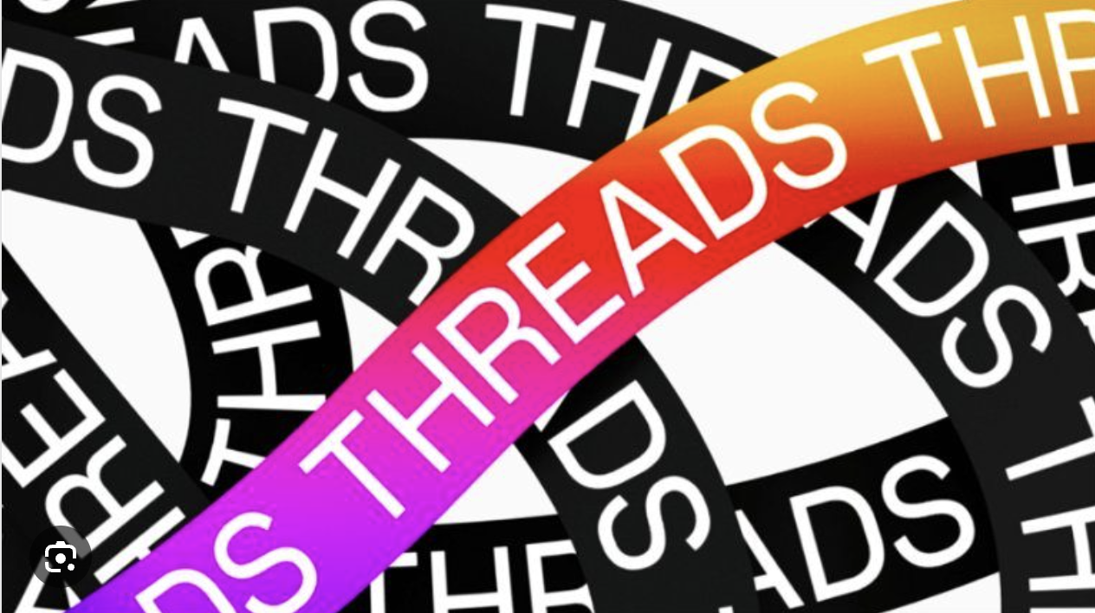
ALY 6020 – FINAL PROJECT
THREADS APP SENTIMENT ANALYSIS
BY- BHAGYASHRI KADAM (BK)
PROFESSOR – BEHZAD AHMADI
DATE – 27th Oct 2023
Notes:
slidesppt.net

Slide 2

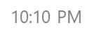
PROJECT WORKFLOW
@ALY6020
1
Data Cleaning, Feature Engineering & EDA
Text Preprocessing & Cleaning
Applying NLP Techniques
Model Building
Model Evaluation & Comparison
Notes:
slidesppt.net
2

Slide 3
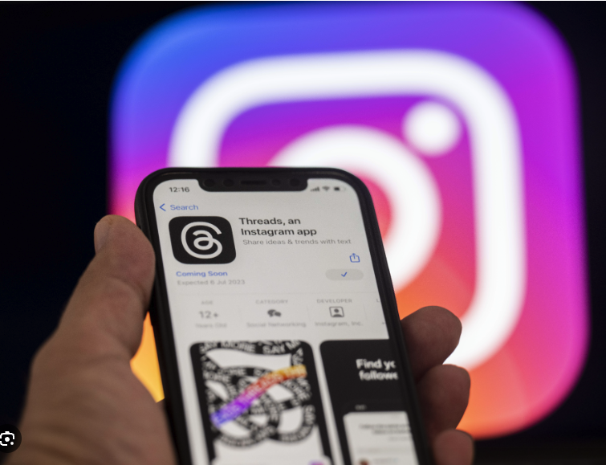
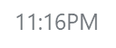
About the Dataset
@kaggle
Records - 32190
Features – 4
Details of User reviews & Ratings for Threads mobile app on Google play store & App store from 5th to 25th July 2023
Target variable – Rating
Notes:
slidesppt.net

Slide 4
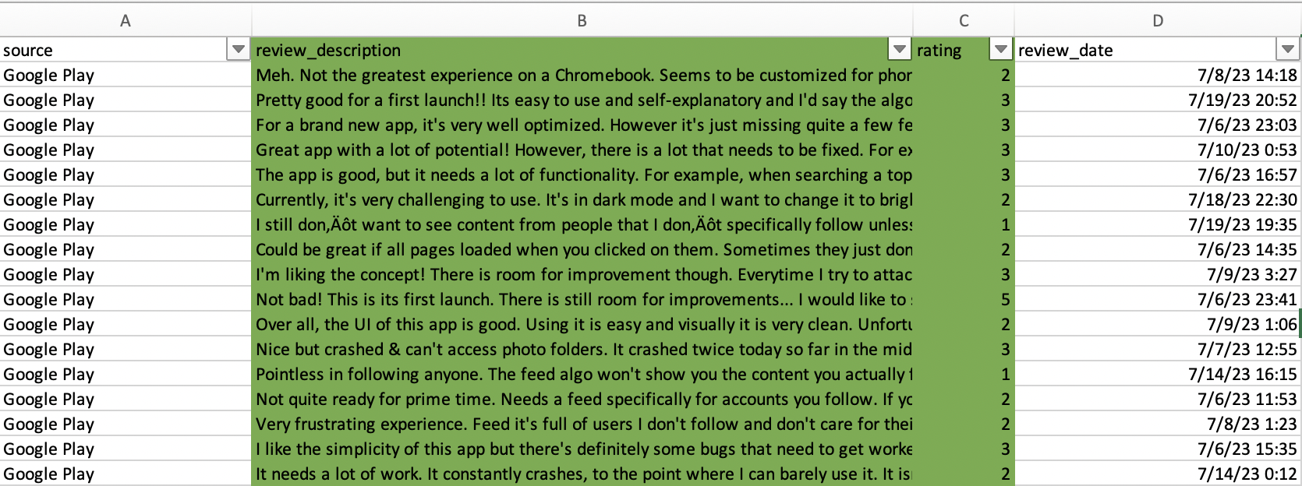
About the Dataset
@kaggle
Notes:
slidesppt.net

Slide 5







Infographic Style
BUSINESS QUESTIONS
Sentiment Distribution of Reviews?
Peak Review times and patterns?
Frequently used words in reviews?
Top reasons for negative ratings or reviews?
Ratings distribution on each platform ?
Ways to improve user satisfaction & overall app rating?
Notes:
slidesppt.net
5

Slide 6
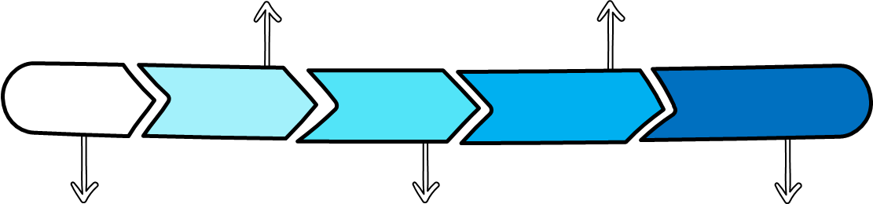
DATA CLEANING
@Threads
Feature Engineering
Recoding columns
Removing duplicate records
Dropping Irrelavent columns
Modifying the datatypes
2:35 AM
Notes:
slidesppt.net

Slide 7
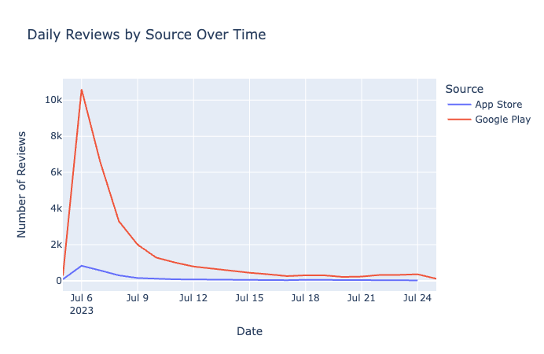
EXPLORATORY DATA ANALYSIS
@Threads
Google play had the highest no of reviews more than 10K on 6th Jul
App store has consistently low reviews over the period with minimal fluctuations.
Noticeable variability in the reviews volume for the two platforms
Notes:
slidesppt.net

Slide 8
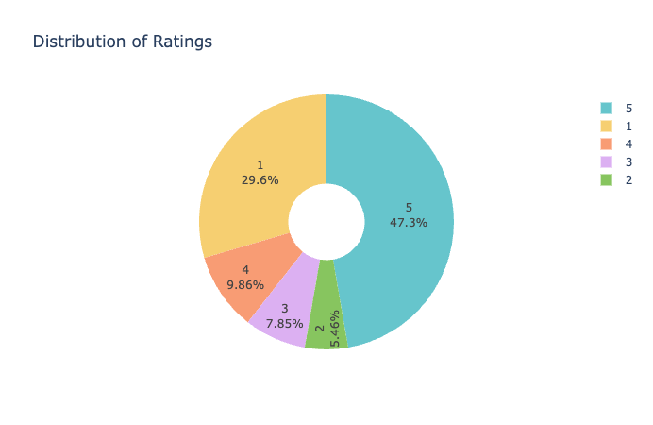
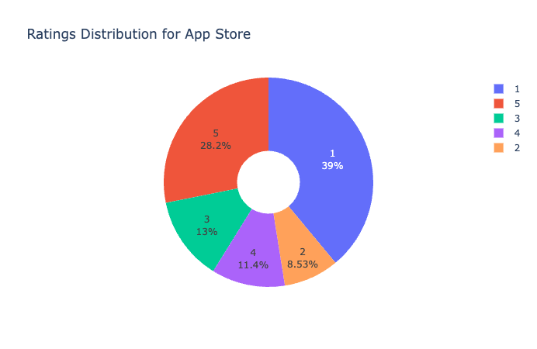
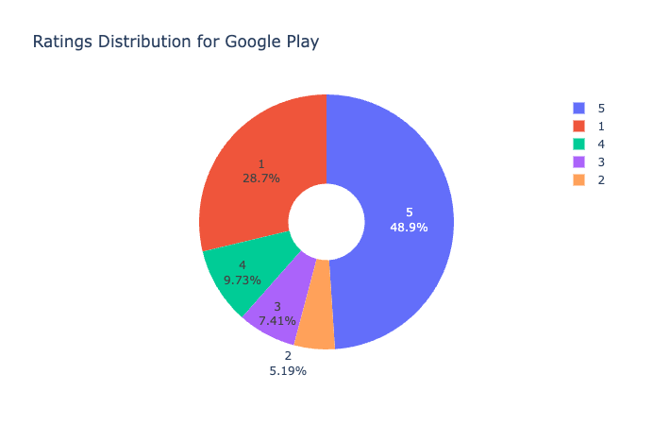
EXPLORATORY DATA ANALYSIS
@Threads
Overall there are significant no of 5-star ratings followed by 1 -star
Google Play has significantly higher no of 5-star ratings as compared to App store
Users on the App Store seem to be more critical, with a higher percentage giving the app a 1-star rating compared to Google Play users.
x

Slide 9
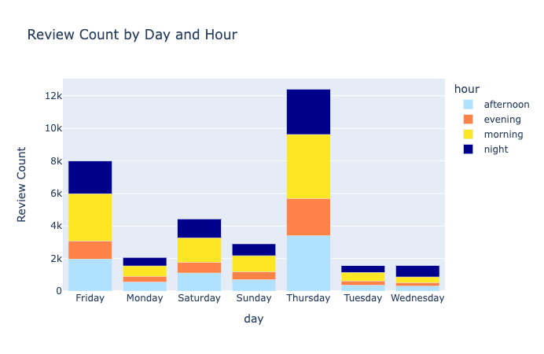
EXPLORATORY DATA ANALYSIS
@Twitter
Thursday Peaks : Thursday morning sees the highest activity with 3934 reviews followed by Thursday afternoon which is 3402.
Additionally, there were 1970 reviews on Friday afternoon and 2903 reviews on morning indicating peak in user activity
Mornings seem to have a more consistent review pattern across the days
The lowest number of reviews is on Wednesday evening, with 215 reviews.
Notes:
slidesppt.net

Slide 10
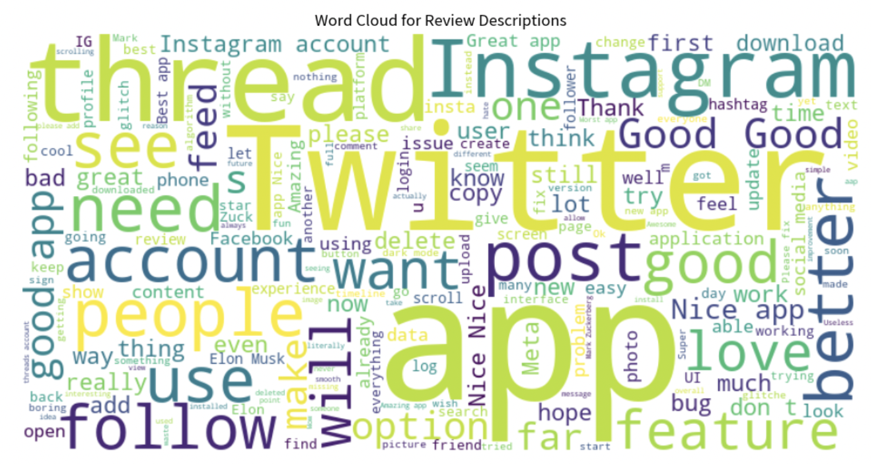
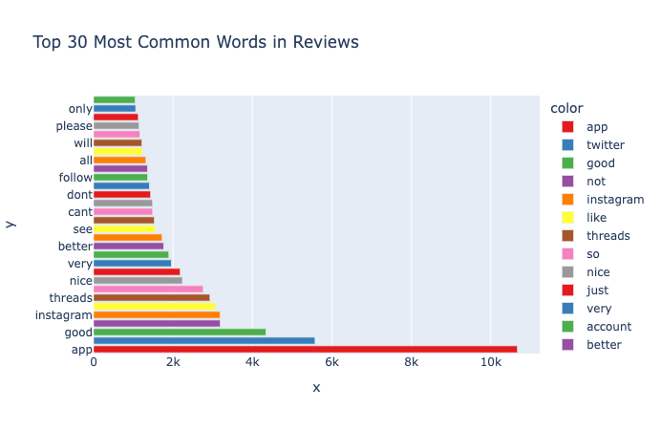
EXPLORATORY DATA ANALYSIS
@Threads
Most common words from review description is “app” , “twitter” , “Instagram” , ”thread”, “nice” , ”account” etc
Notes:
slidesppt.net

Slide 11
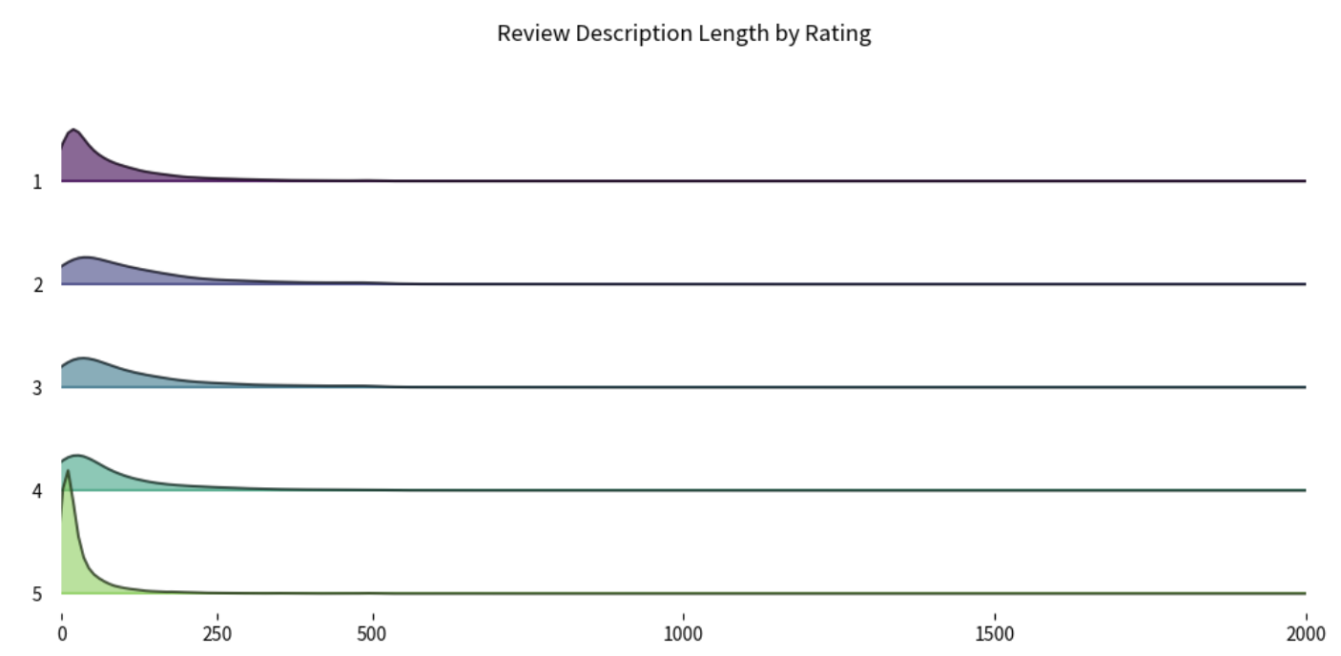
EXPLORATORY DATA ANALYSIS
@Threads
Most reviews across all ratings tend to be shorter length below 250 chars
Reviews rated 1 have shorter descriptions. Ratings 2 have a similar trend but the descriptions looks slightly longer on average.
For Ratings 3 & 4, the review lengths look evenly distributed
Reviews with rating 5 , we can see a peak indicating the most descriptions concentrated at the lower end. under 250 chars.
Notes:
slidesppt.net

Slide 12
SENTIMENT ANALYSIS APPROACH ( NLP TECHNIQUES)
BAG OF WORDS MODEL
TF-IDF MODEL
Generalization of the Bag of Words model which uses the Term Frequency and Inverse Document frequency approach.
TF-IDF usually performs better in machine learning models.
TF-IDF model contains information on the more important words and the less important ones as well.
Simplest form of text representation in numbers.
Represents a sentence as a bag of words vector
Bag of words are easy to interpret
Notes:
slidesppt.net
12

Slide 13
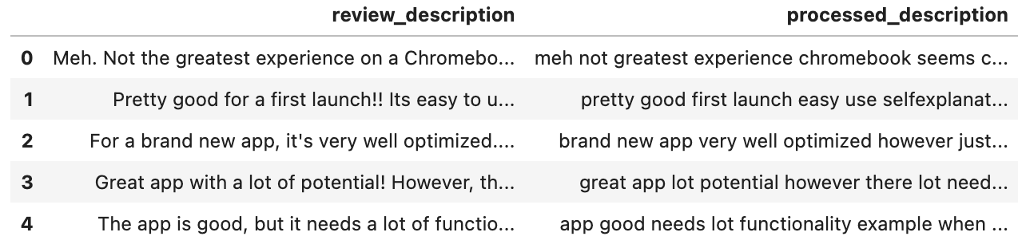
TEXT PRE-PROCESSING
@Threads
Clubbing the ratings 1:-1, 2:-1, 3:0, 4:1, 5:1
Using regular expression library to remove urls, emojis , punctuations , stopword removal , convert to lowercase etc,
1
2
Using the processed reviews description from Step 2 to do the Word frequency analysis
Using TF-IDF Vectorizer from scikit-learn to convert processed text descriptions in to a matrix of TF-IDF values
3
4
Notes:
slidesppt.net

Slide 14
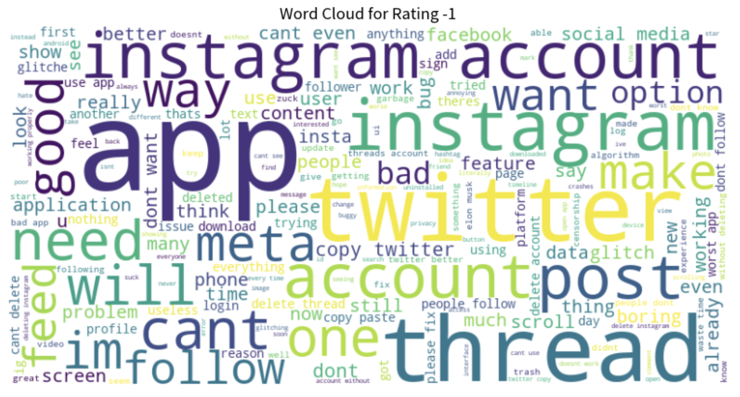
WORD CLOUD
@Threads
Word size in the matrix indicated frequency (larger words = higher occurrence).
Most prominent words for Rating -1 are Instagram, Twitter, account , app , thread , want & post.
Negative words like "bad", "glitch", "problem", "delete", "issue", "boring", and "cant" (can't) suggest that many users have had unsatisfactory experiences with the app or platform.
Notes:
slidesppt.net

Slide 15
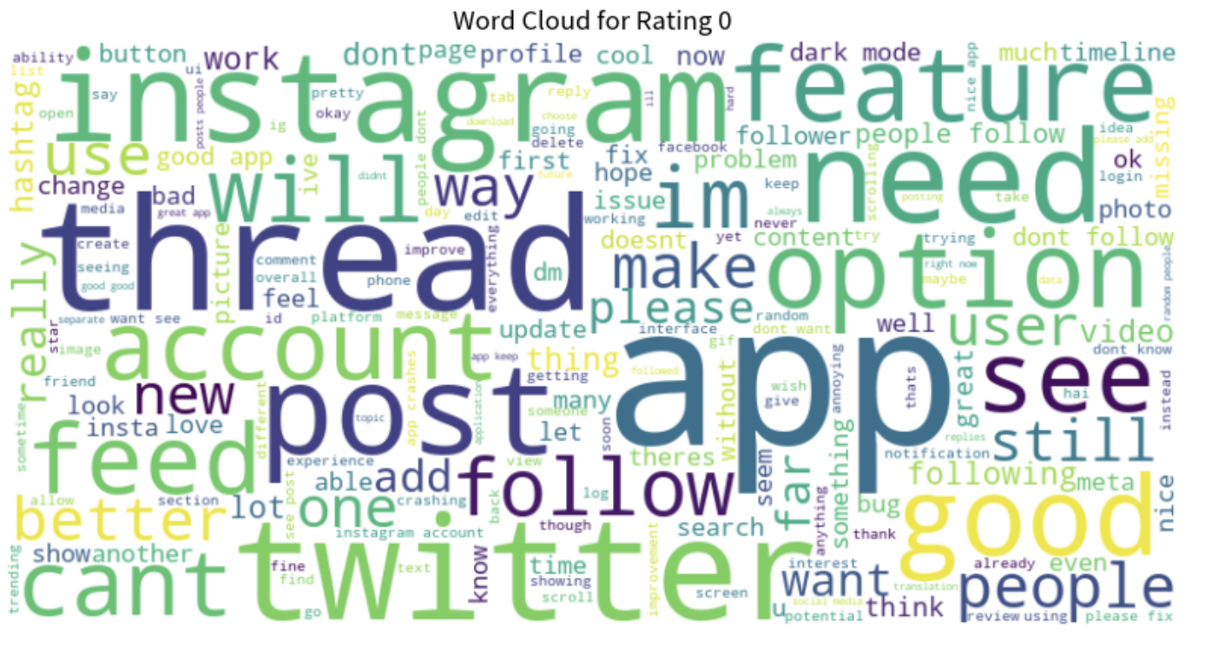
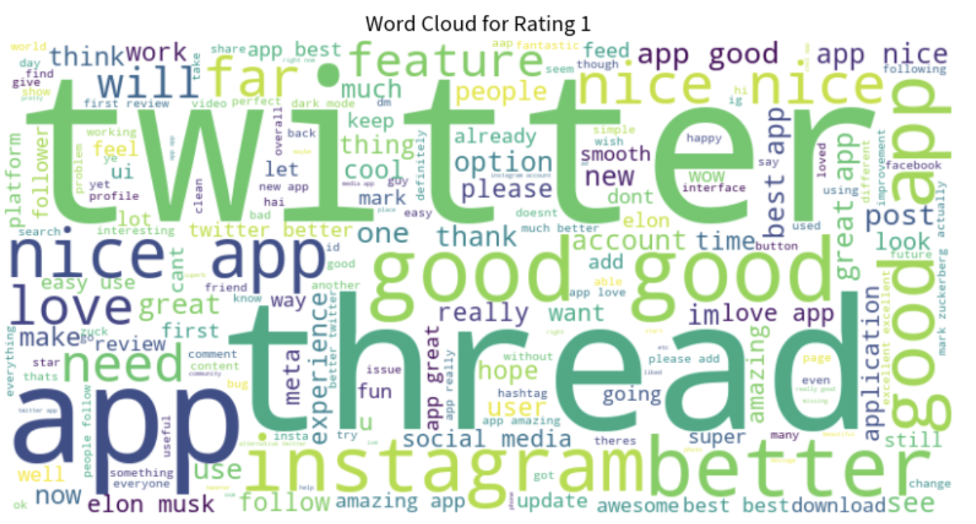
WORD CLOUD
@Threads
For Rating 0 - A mix of both positive ("good", "love", "like", "better", "nice") and negative words ("bad", "problem", "issue", "bug", "cant" [can't]) hint at a balanced view, reflective of the neutral rating.
For Rating 1 - Predominantly positive sentiments can be observed with words like "love", "great", "good", "nice", "best", "amazing", "happy", "cool", and "wow".
Notes:
slidesppt.net

Slide 16
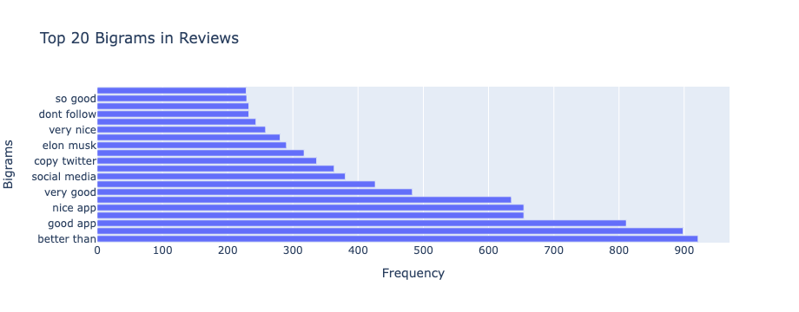
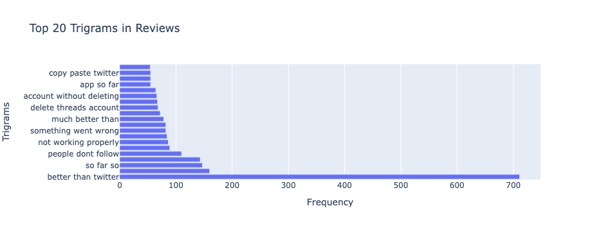
EXPLORATORY DATA ANALYSIS
@Threads
Positive feedback : Phrases like "so good," "very nice," "very good," "good app," and "nice app" appear to be quite frequent, suggesting that there is positive feedback
Comparison with twitter : Bigrams like "copy twitter" and "better than" and trigrams like "copy paste twitter," "much better than," and "better than twitter" strongly indicate comparison with Twitter
Notes:
slidesppt.net

Slide 17
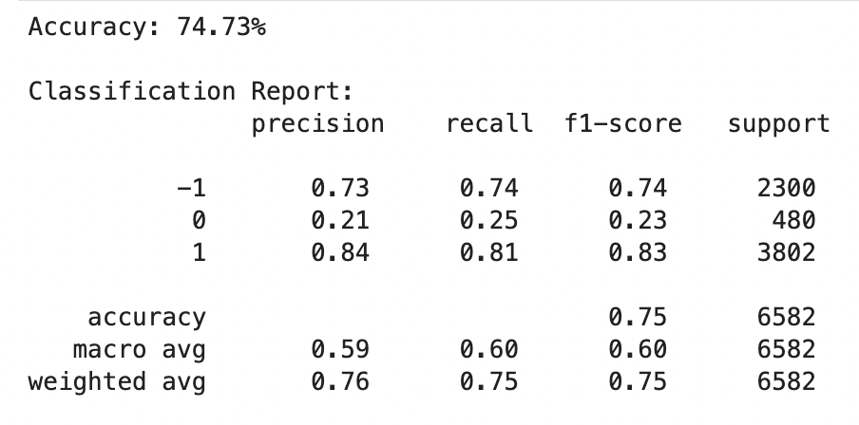
RANDOM FOREST MODEL
@Threads
A Random Forest classifier is initialized with 100 trees (n_estimators)
As there was class imbalance , applied SMOTE to create samples for the minority class in the training data
Overall RF Model accuracy is 74.73 %
Model demonstrates good performance for classes -1 and 1 with high precision, recall, and F1-scores. However, it struggles with class 0,
or
After SMOTE :
Notes:
slidesppt.net

Slide 18
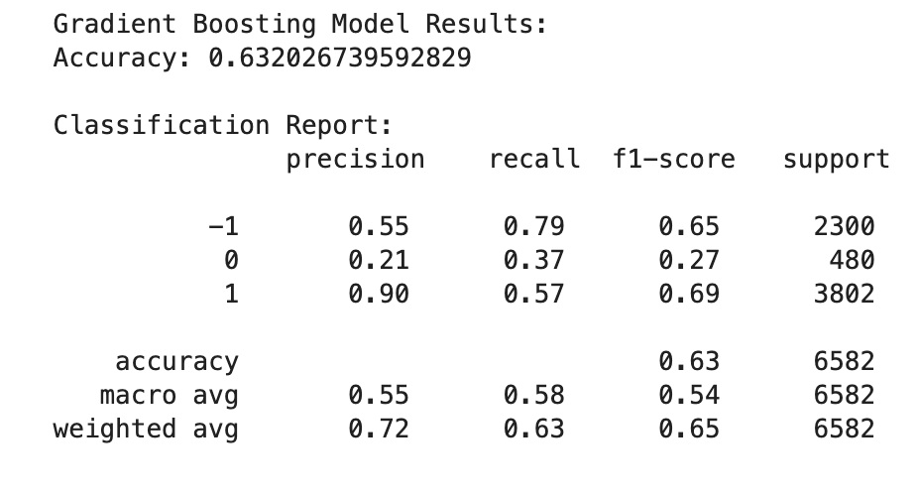
GRADIENT BOOST MODEL
@Threads
The Gradient Boosting classifier is trained using the training data that has been balanced using the SMOTE technique.
Overall GBM Model accuracy is 63.207 %
Model performs well for Class 1 followed by Class -1 and class 0 looking at the f1-scores.
The recall for class 0 has increased in the Gradient Boosting model compared to the Random Forest, suggesting it might be better at capturing the actual instances of this class.
or
Notes:
slidesppt.net

Slide 19
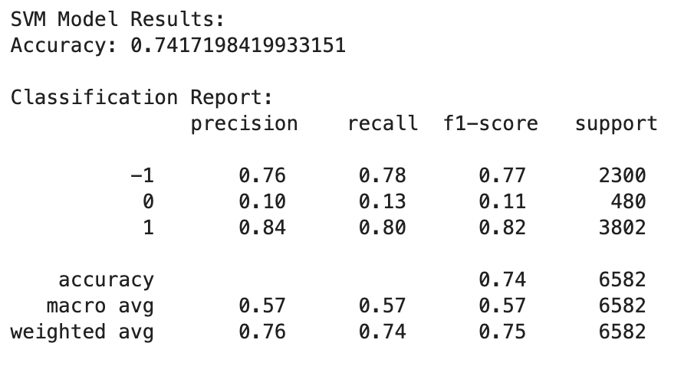
SVM Model
@Threads
The SVM classifier is trained using the training data that has been balanced using the SMOTE technique.
Overall SVM Model accuracy is 74.17 %
Model is performing reasonably well for classes -1 and 1 with high precision, recall, and F1-scores. However, it struggles with class 0
Notes:
slidesppt.net

Slide 20
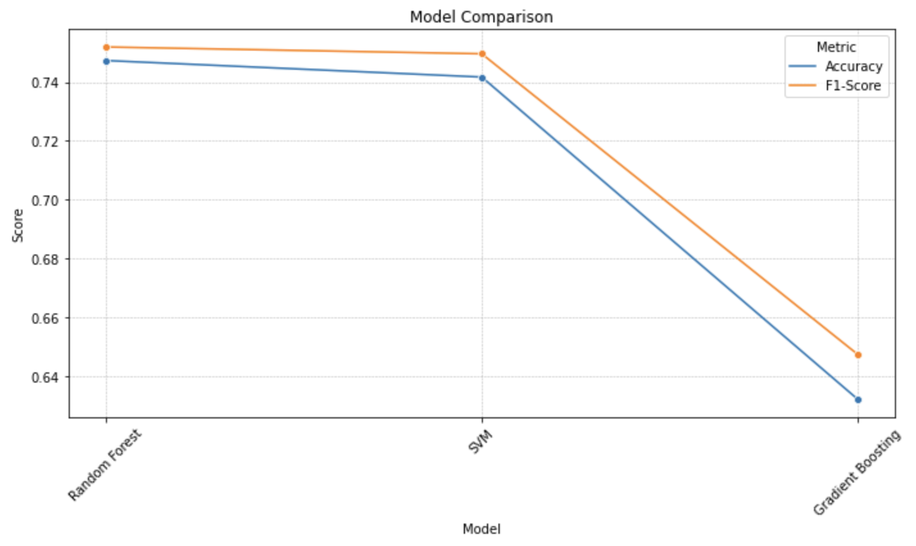
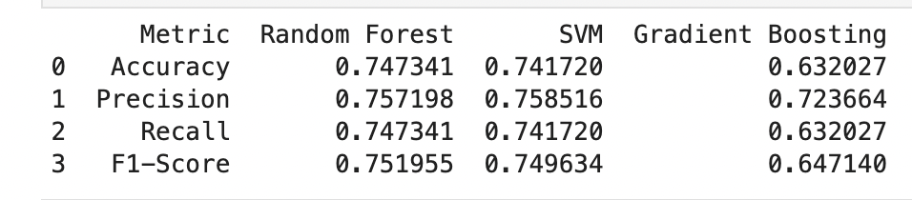
"Come on Mark! Could you stop mimicking Elon?? I hate you."]
MODEL COMPARISON
@Threads
Overall the Random Forest and SVM models have comparable high performance in terms of both Accuracy and F1-Score, making them seem more reliable for this sentiment analysis task.
Notes:
slidesppt.net

Slide 21
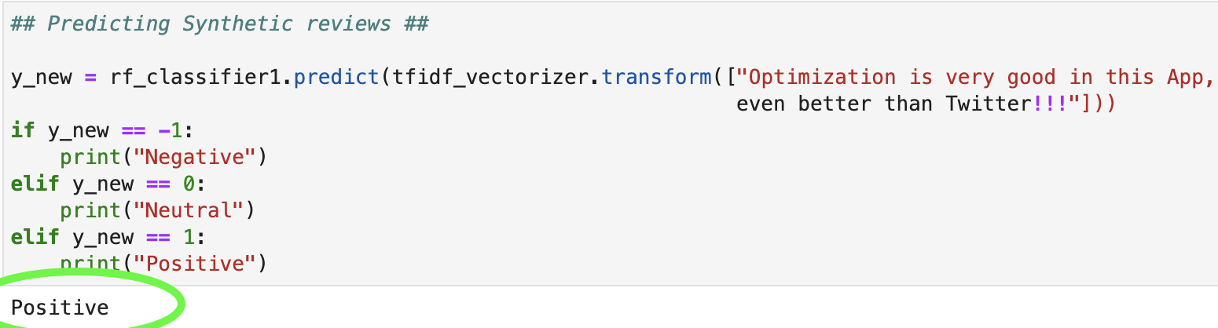
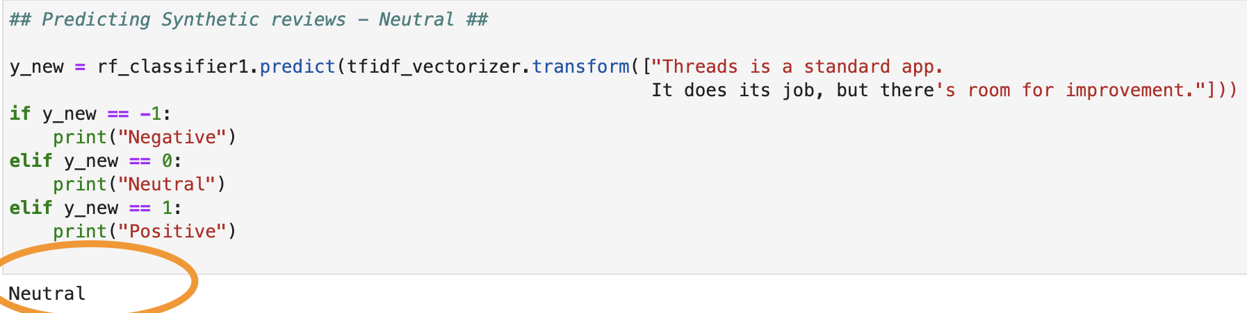
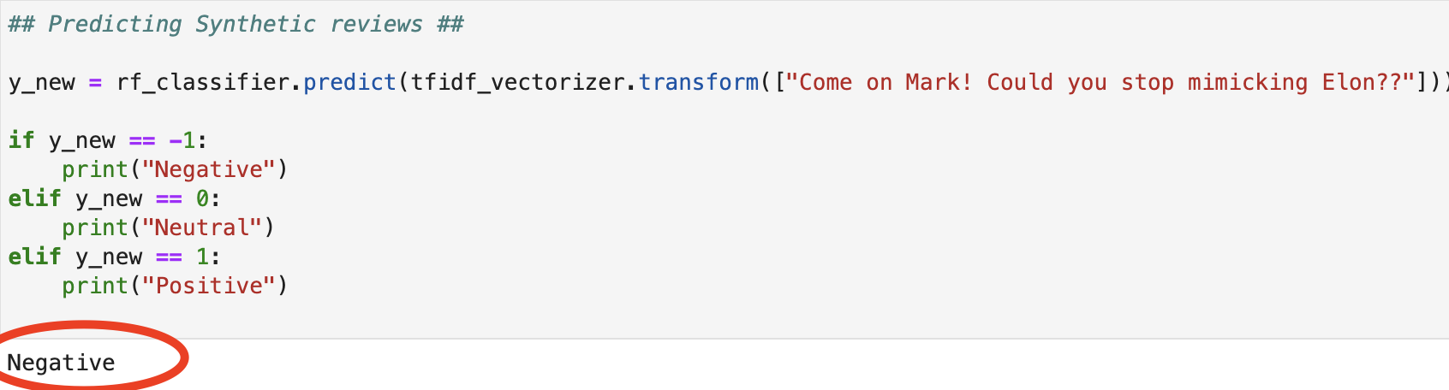
"Come on Mark! Could you stop mimicking Elon?? I hate you."]
Predicting Reviews
@Threads
PO
Notes:
slidesppt.net

Slide 22
"Come on Mark! Could you stop mimicking Elon?? I hate you."]
References
@Threads
PO
Dataset Link : https://www.kaggle.com/datasets/saloni1712/threads-an-instagram-app-reviews/data
https://www.datacamp.com/tutorial/random-forests-classifier-python
https://towardsdatascience.com/master-machine-learning-random-forest-from-scratch-with-python-3efdd51b6d7a
https://www.analyticsvidhya.com/blog/2020/02/quick-introduction-bag-of-words-bow-tf-idf/
https://www.analyticsvidhya.com/blog/2021/09/gradient-boosting-algorithm-a-complete-guide-for-beginners/
Notes:
slidesppt.net

Slide 23


Thank you, see you on next presentation!
Any Questions ?

